Slide 1

Emotion-Aware Music Recommendation System
Sai Suman Chitturi (1602-18-733-097)
Praneeth Kapila (1602-18-733-116)

Slide 2
Introduction
Recommend Music based on User's Current Emotion
Implicit: Facial Emotion, Keystrokes, Mouse-click patterns
Emotion Identification
Explicit: Input from User
Collaborative Filtering: Based on Similar Users
Music Recommendation
Content Based: Based on Similar Content

Slide 3
Motivation
Lack of Context-aware Music Recommendation system
Constantly Expanding Digital Music Libraries
Difficult to recall a particular song matching the current mood
Confusion while choosing songs
Useful when users can't reveal or express their emotion

Slide 4
Flow
Facial Expression
Web Cam
Capturing
Song
Recommend
Emotion
Detection
Data Set
Data Set

Slide 5
Literature Review: Emotion Detection
Parameter | CNN | Deep Face (DNN) | FER (MTCNN)
Accuracy | High | Low | High
Train time | Fast | Slow | Slow
Validation time | Fast | Slow | Slow
Advantages | Speed | Light Weight | Self-alignment of Face
Disadvantages | Large Training Data | Low Accuracy | Slow
Common | Unable to detect rare facial expressions like Disgust

Slide 6
Proposed Methodology: Emotion Detection
Based on the accuracies, both, CNN and MTCNN, seem a good fit for Facial Emotion Detection
Choose CNN if time is an Important Factor
Choose MTCNN if Accuracy is more important
Time factor can be reduced by using GPUs.
MTCNN is better than CNN

Slide 7
Partial Implementation
Datasets used:
FER2013: 28k train images + 7k test images; 48x48; B&W
Affect Net: 49k train images + 4k test images; 224x224; Colored
Parameter | CNN | Deep Face (DNN) | FER (MTCNN)
Train Accuracy | 66.1 % | 97.35 % | 75.42 %
Test Accuracy | 34.2 % | 22.8 % | 35.8 %
Train Dataset | FER 2013 Train | FER 2013 Train | FER 2013 Train
Test Dataset | Affect Net | Affect Net | Affect Net

Slide 8
Work to be done
Part – 2: Music Recommendation System based on the Emotion Detected in Part – 1
Generate a Dataset using Spotify API
Two approaches: Content-based and Collaborative filtering
Recommend top K songs? (KNN)

Slide 9
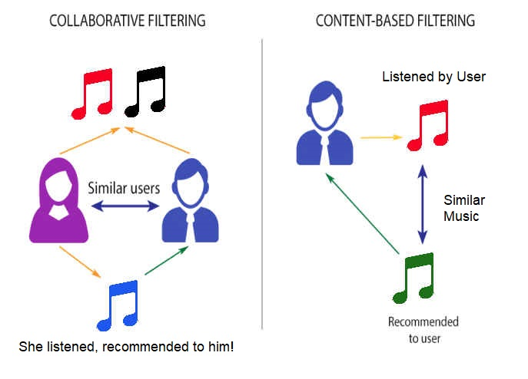
Methods for
Recommendation

